Slide 1
3D Computer Vision
Dr. Hassan Foroosh
School of EECS
UCF

Slide 2
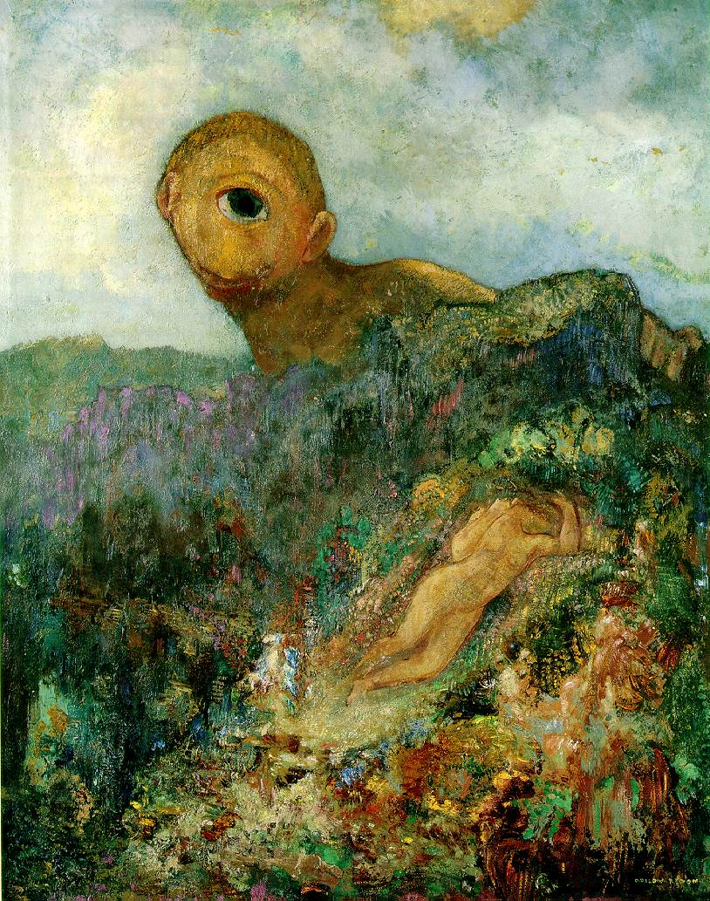
Camera Geometry
Camera model
Camera calibration
Single view geometry

Slide 3
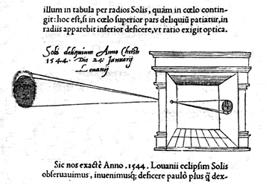

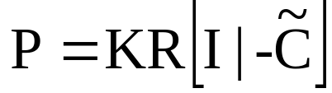
Pinhole camera

Slide 4
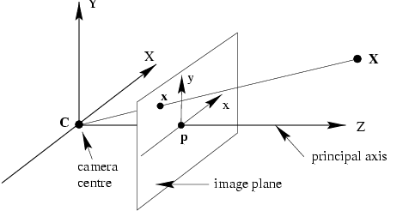
Camera anatomy
Camera center
Column points
Principal plane
Axis plane
Principal point
Principal ray

Slide 5
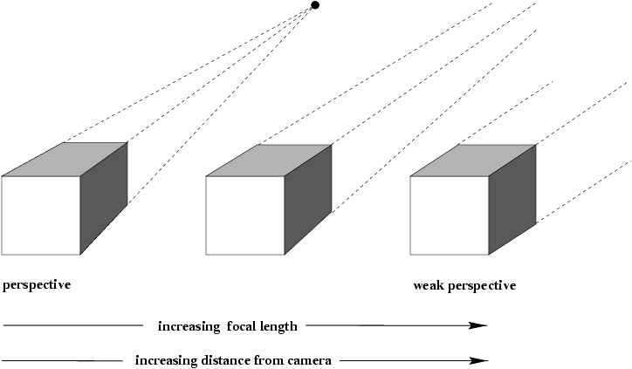
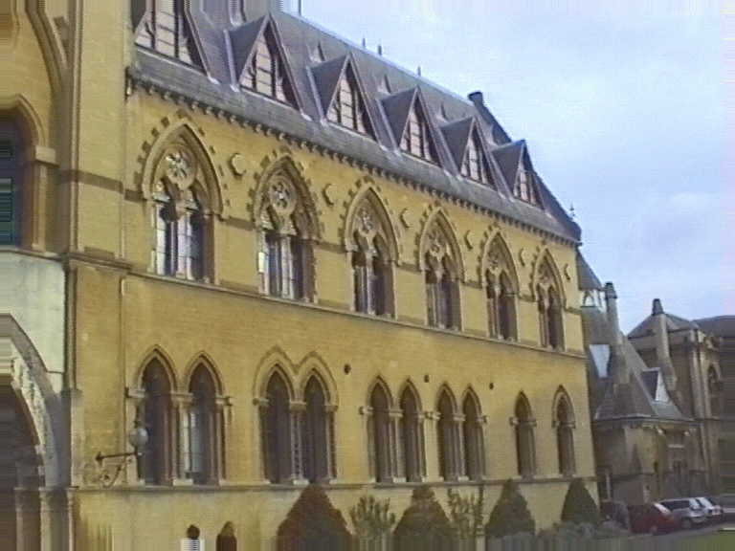
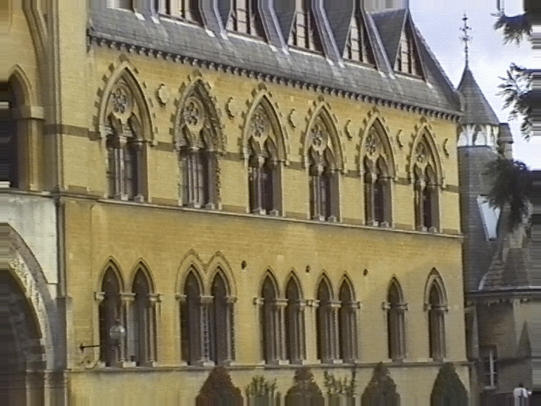
Affine cameras

Slide 6
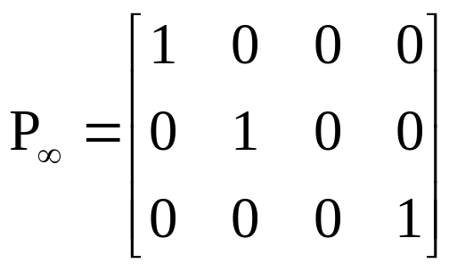
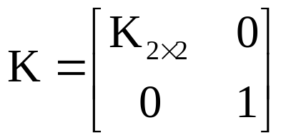
Summary parallel projection
canonical representation
calibration matrix
principal point is not defined

Slide 7
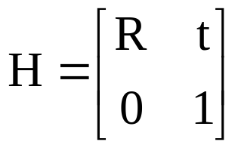
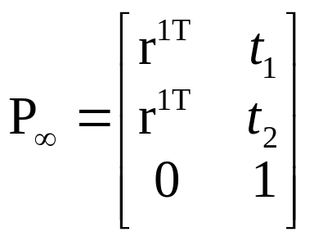
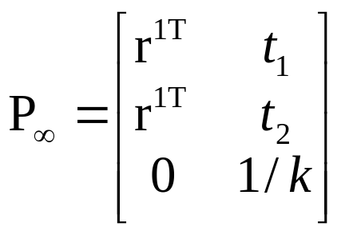
A hierarchy of affine cameras
Orthographic projection
(5dof)
Scaled orthographic projection
(6dof)

Slide 8
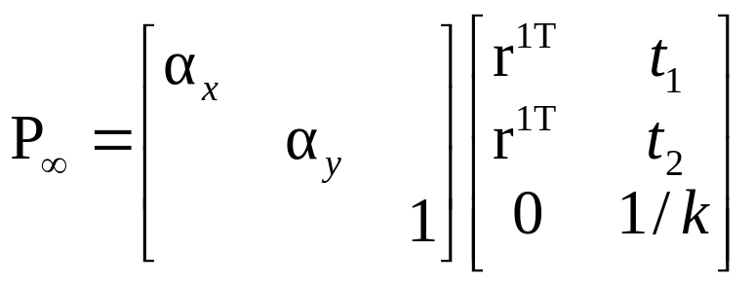
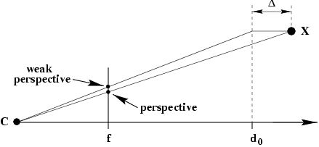
A hierarchy of affine cameras
Weak perspective projection
(7dof)

Slide 9
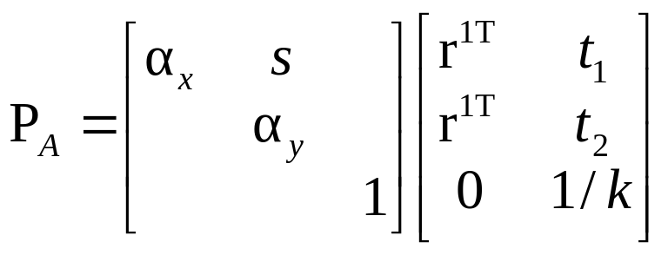
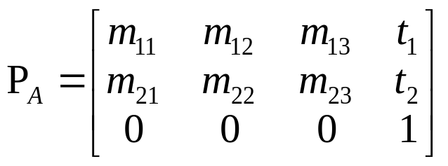
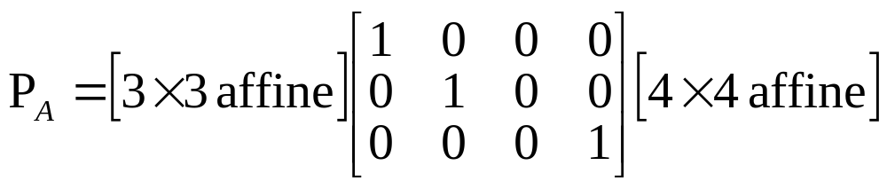
A hierarchy of affine cameras
Affine camera
(8dof)
Affine camera=camera with principal plane coinciding with Π∞
Affine camera maps parallel lines to parallel lines
No center of projection, but direction of projection P_{A}D=0
(point on Π∞)

Slide 10

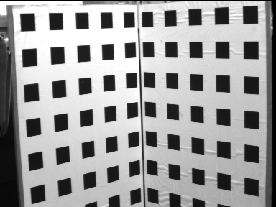
Camera calibration

Slide 11


Resectioning

Slide 12


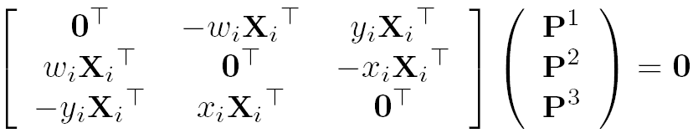
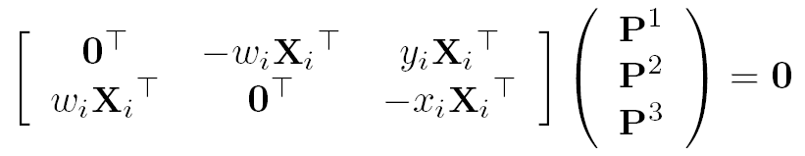

Basic equations

Slide 13

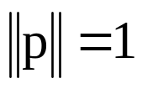
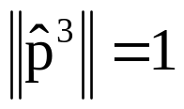


Basic equations
minimal solution
P has 11 dof, 2 independent eq./points
5½ correspondences needed (say 6)
Over-determined solution
n ≥ 6 points
minimize subject to constraint

Slide 14
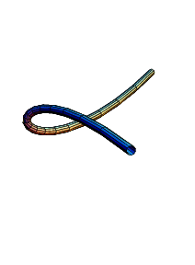
Degenerate configurations
More complicate than 2D case
  Camera and points on a twisted cubic
  Points lie on plane or single line passing
  through projection center

Slide 15


Data normalization
Less obvious
(i) Simple, as before
(ii) Anisotropic scaling

Slide 16
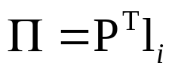
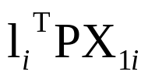
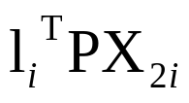
Line correspondences
Extend DLT to lines
(back-project line)
(2 independent eq.)

Slide 17
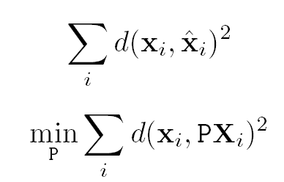
Geometric error

Slide 18


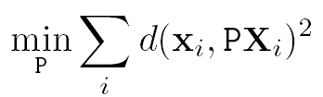

Gold Standard algorithm
Objective
Given n≥6 3D to 2D point correspondences {X_{i}↔x_{i}’}, determine the Maximum Likelyhood Estimation of P
Algorithm
Linear solution:
  Normalization:
  DLT:
Minimization of geometric error: using the linear estimate as a starting point minimize the geometric error:
Denormalization:
~
~
~

Slide 19
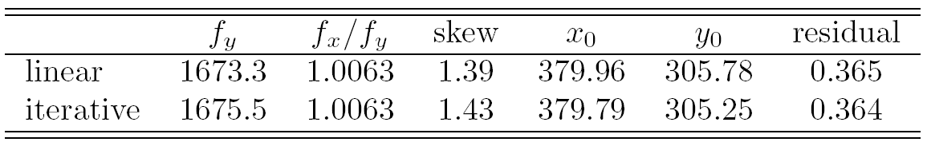
Calibration example
Canny edge detection
Straight line fitting to the detected edges
Intersecting the lines to obtain the images corners
typically precision <1/10
(rule of thumb: 5n constraints for n unknowns

Slide 20
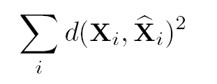
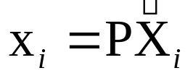
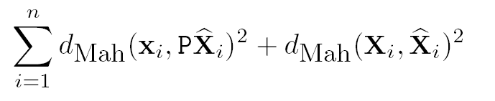

Errors in the world
Errors in the image and in the world

Slide 21
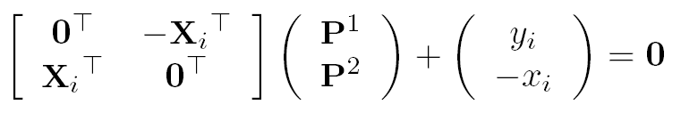
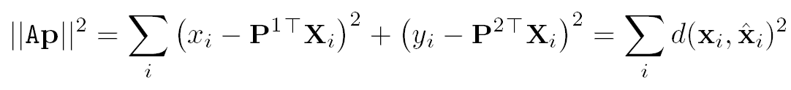
Estimation of affine camera
note that in this case algebraic error = geometric error

Slide 22

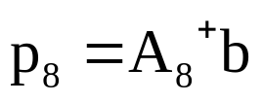
Gold Standard algorithm
Objective
Given n≥4 3D to 2D point correspondences {X_{i}↔x_{i}’}, determine the Maximum Likelyhood Estimation of P
(remember P^{3T}=(0,0,0,1))
Algorithm
Normalization:
For each correspondence
solution is
Denormalization:

Slide 23
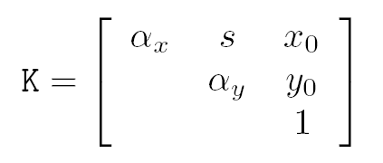
Restricted camera estimation
Find best fit that satisfies
skew s is zero
pixels are square
principal point is known
complete camera matrix K is known
Minimize geometric error
impose constraint through parametrization
Image only R⁹ → R^{2n}, otherwise R^{3n+9} → R^{5n}
Minimize algebraic error
assume map from param q → P=K[R|-RC], i.e. p=g(q)
minimize ||Ag(q)||

Slide 24
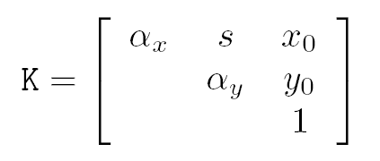
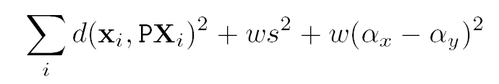
Restricted camera estimation
Initialization
Use general DLT
Clamp values to desired values, e.g. s=0, α_{x}= α_{y}
Note: can sometimes cause big jump in error
Alternative initialization
Use general DLT
Impose soft constraints
gradually increase weights

Slide 25
Exterior orientation
Calibrated camera, position and orientation unkown
→ Pose estimation
6 dof ⇒ 3 points minimal (4 solutions in general)

Slide 26
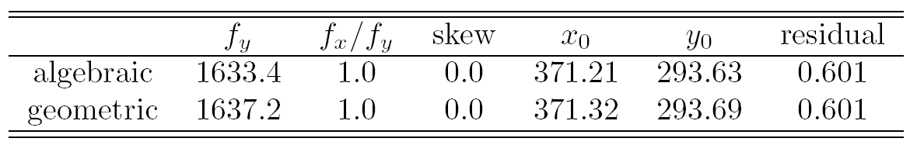

Slide 27
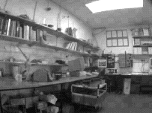
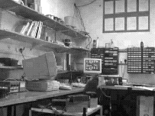
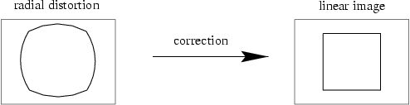
Radial distortion
short and long focal length

Slide 28
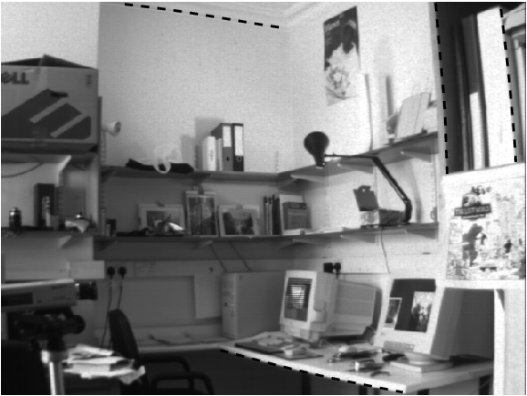
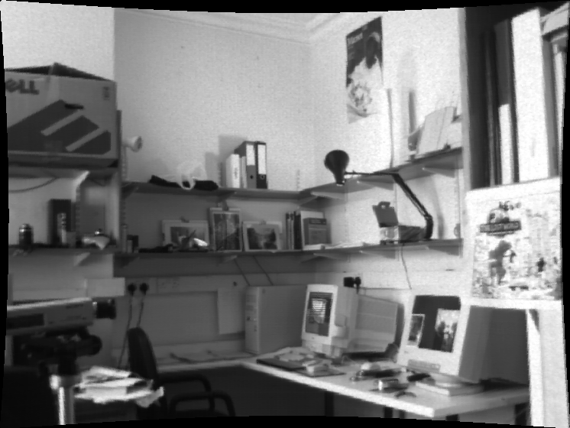

Slide 29

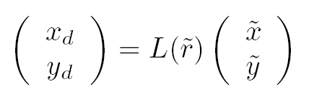

Slide 30


Correction of distortion
Choice of the distortion function and center
Computing the parameters of the distortion function
Minimize with additional unknowns
Straighten lines
…

Slide 31
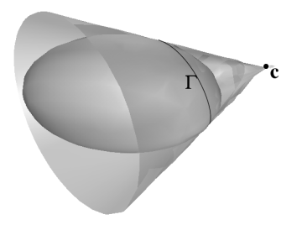


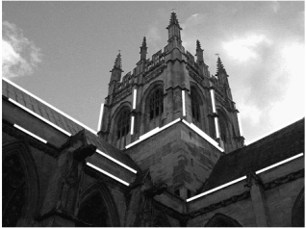
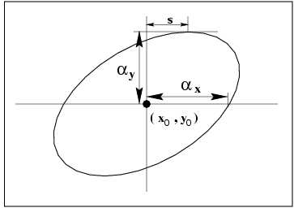
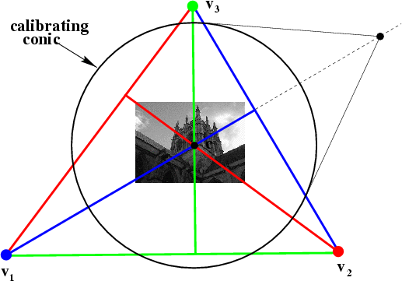
Next class:
More Single-View Geometry
Projective cameras and
planes, lines, conics and quadrics.
Camera calibration and vanishing points, calibrating conic and the IAC

